Slide 1

CS527 Project #1
Prof. Saed Sayad
Department of Computer Science
Spring 2020

Slide 2
Build Your Team
Each team consists of 4-6 students.
Each team needs an administrator
Send your team info to Sakai.
Start Date: 2020-02-10
Presentation Date: 2020-03-02

Slide 3
Project – ETL (Extraction, Transformation and Loading)
Create an AWS account (1)
Launch an EC2 micro instance (1)
Create a S3 Bucket (1)
Download Instacart (2)
Upload Instacart data to S3 (1)
Start a RDS (MySQL/ORACLE/SQL Server) Instance (1)
Export data from S3 to MySQL (3)
Start a Redshift Instance (1)
Export data from S3 to Redshift (3)

Slide 4
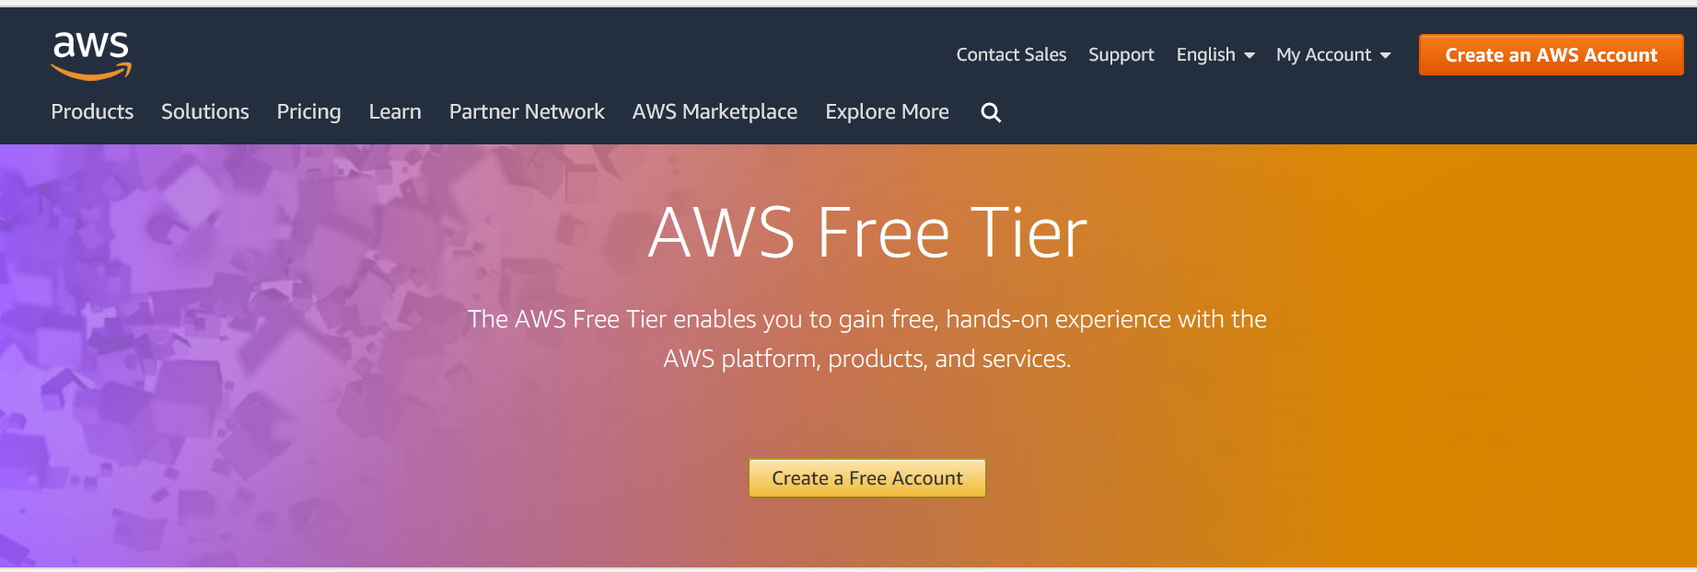
1. Create an AWS account
https://aws.amazon.com/free/

Slide 5
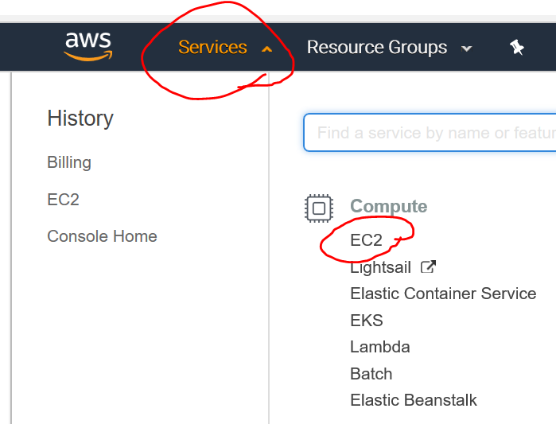
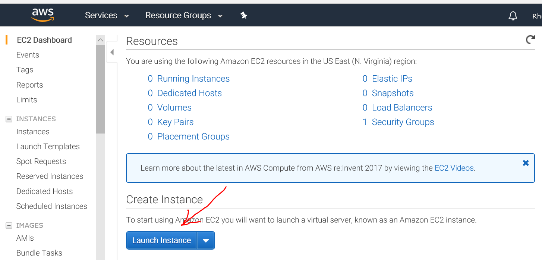
2. Launch an EC2 micro instance

Slide 6
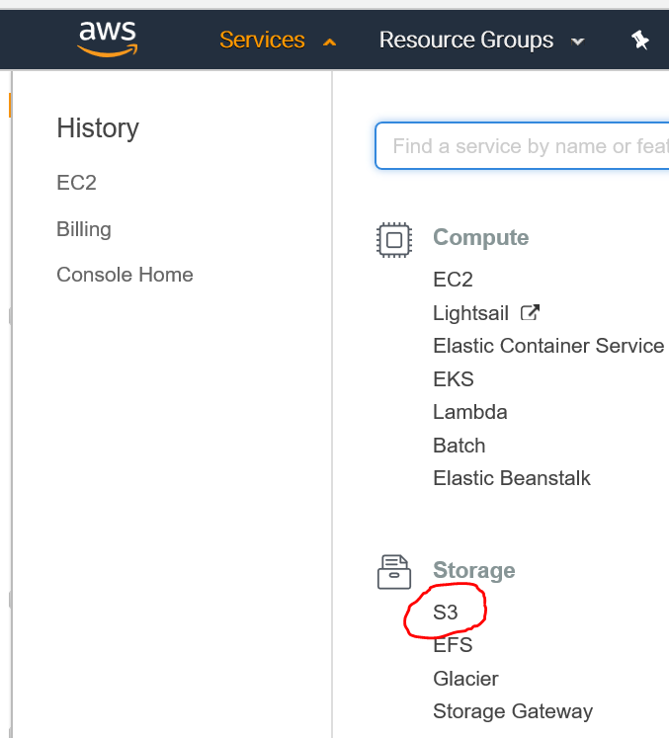
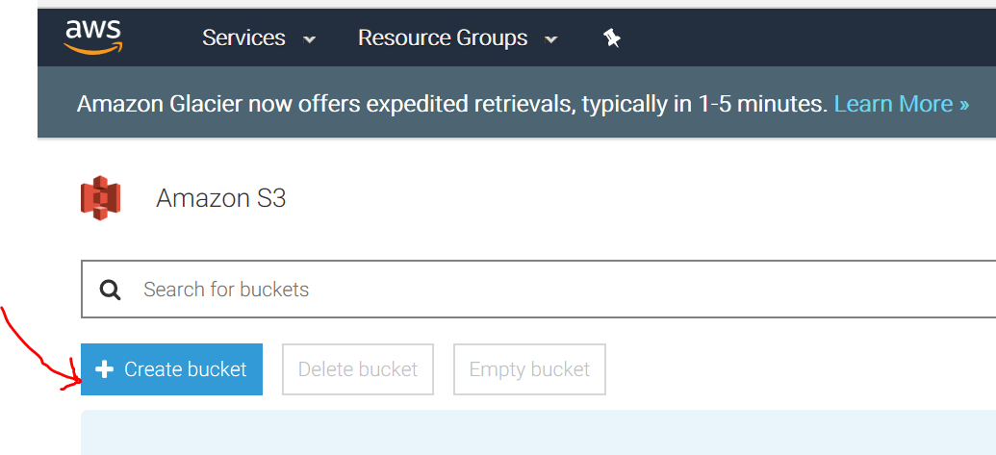
3. Create a S3 Bucket

Slide 7
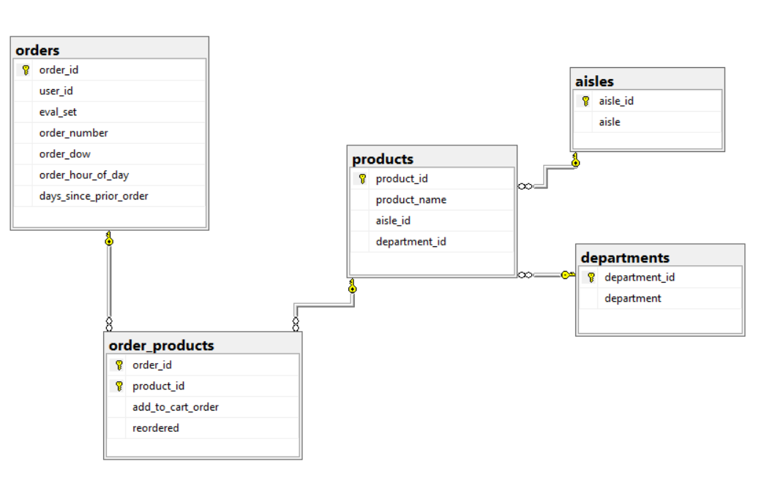
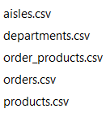
4. Download Data ( Instacart & GEO)
Instacart
Instacart.zip

Slide 8
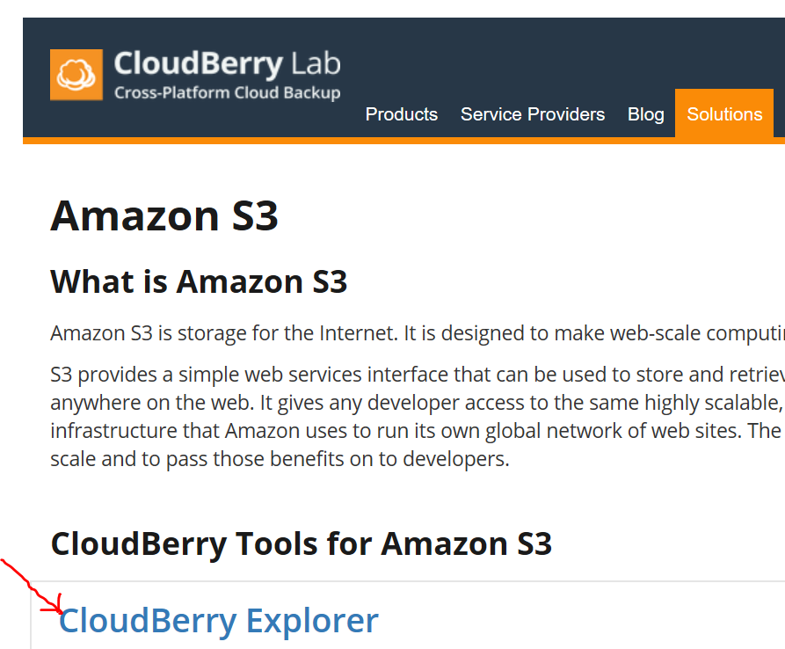
5. Upload Instacart data to S3

Slide 9
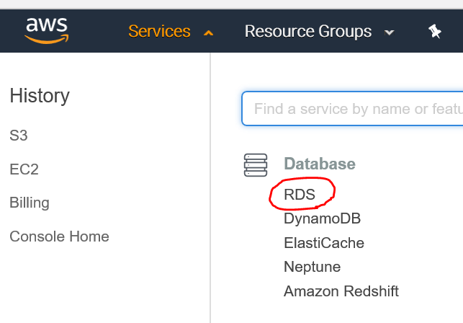
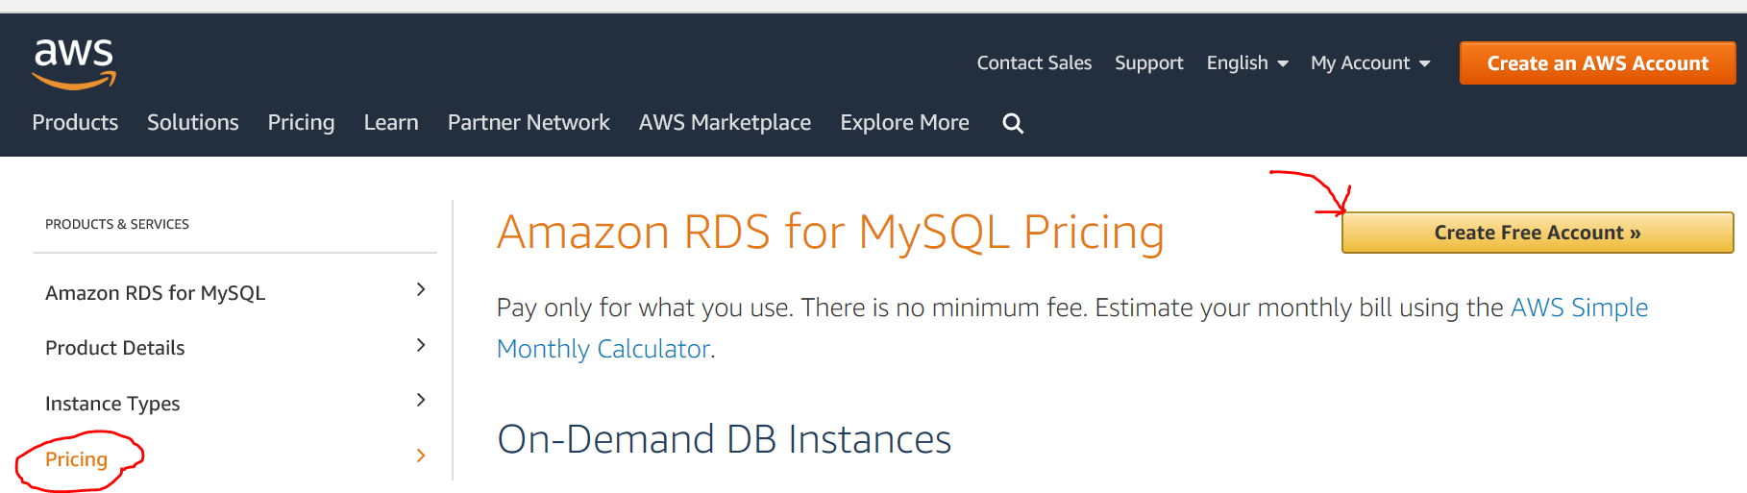
6. Start a RDS Instance

Slide 10
7. Export data from S3 to MySQL
Use JDBC or ODBC Connectivity

Slide 11
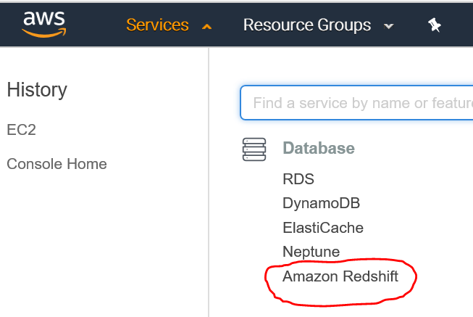
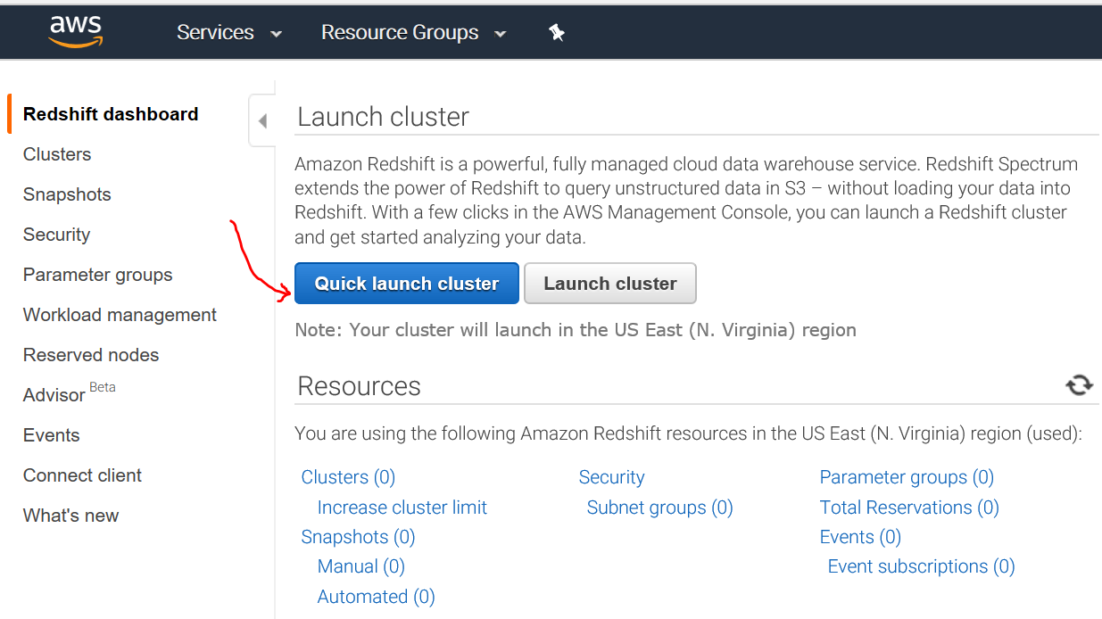
8. Start a Redshift Instance

Slide 12
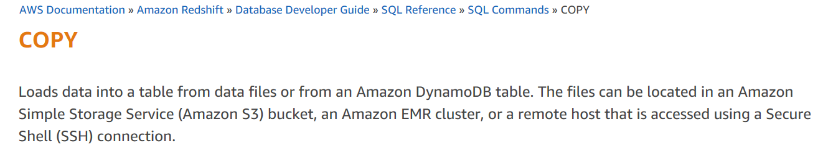
9. Export data from S3 to Redshift
Use JDBC or ODBC Connectivity
Use Redshift “COPY” function

Slide 13
Project - Homework Assignments
Practice the SQL scripts on the following website against your data on MySQL and Redshift.
SQL Tutorial > https://www.w3schools.com/sql/default.asp
Students will be asked to write 10 different SQL codes (10)

Slide 14
Project - Web Application
The web application should be able to connect to both MySQL and Redshift (4)
The web app accepts SQL scripts as an input (1)
The web app executes SQL scripts and shows the correct results (10)
The web app shows the elapsed time (1)

Slide 15
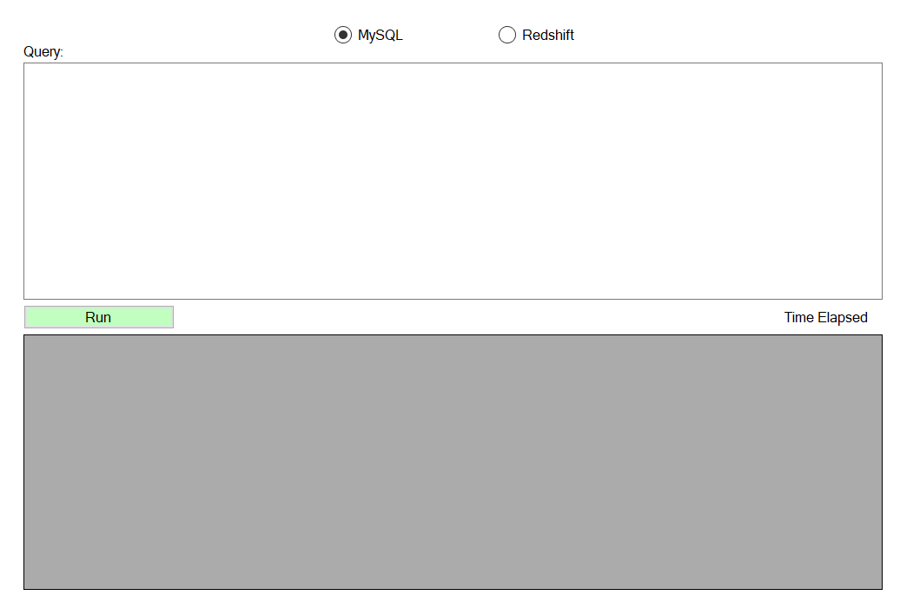
Web Application

Slide 16
Project - Marking
Project | Team | Individual
ETL Process | 14
Homework Assignments |  | 10
Web Application | 16
Total | 40

Slide 17



Project #2

Slide 18


